Slide 1
Handling of Cryogenics Substances
2023

Slide 2
Learning Objectives
Attendees will be able to:
Define cryogenics
Know the characteristics & types of cryogenic liquids
Have an understanding of different uses of cryogenics
Understand the hazards involved in handling cryogenics
Have an understanding of First Aid/emergency procedures & requirements of PPE
Know the safety precautions / consideration concerning dewar
Get an idea of the cause of incidents involving cryogens

Slide 3
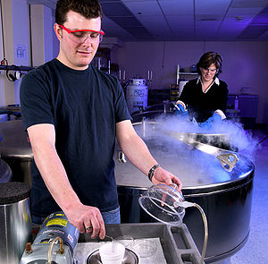
Definition
Cryogenic liquids are liquefied gases that are kept in their liquid state at very low temperatures.
The word "cryogenic" means "producing, or related to, low temperatures,“
Cryogenic liquids have boiling points below -150°C

Slide 4
Characteristics
All cryogenic liquids are gases at normal temperatures and pressures.
Different cryogens become liquids under different conditions of temperature and pressure,
But all have two properties in common:
they are extremely cold, and
small amounts of liquid can expand into very large volumes of gas.

Slide 5
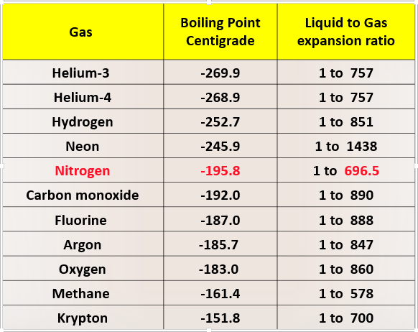
Some of the Cryogenic Liquids

Slide 6
Types of Cryogenic Liquids
Inert Gases: Inert gases do not react chemically to any great extent. They do not burn or support combustion. Nitrogen, helium, neon, argon and krypton.
Flammable Gases: Some cryogenic liquids produce a gas that can burn in air. Hydrogen, methane and liquefied natural gas.
Oxygen: Many materials considered as non-combustible can burn in the presence of liquid oxygen.

Slide 7
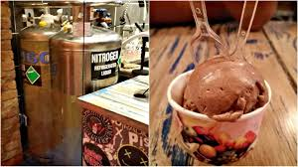
Uses of Liquid Nitrogen
As a source of very dry nitrogen gas- (Purging)
To store cells for laboratory work
The immersion freezing / transportation of food products and making ultra-smooth ice cream
As a coolant for super computers and CCD cameras in astronomy.
As a coolant to temporarily “shrink” mechanical components during machine assembly
Freezing water pipes in order to work on them to block water flow to the work area.

Slide 8
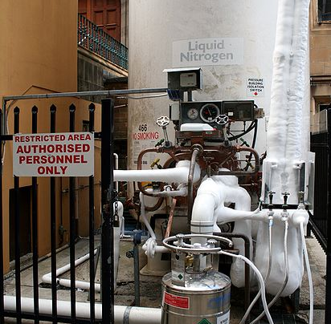
Health Hazards
Asphyxiation Hazard
Extreme Cold Hazard
Toxic Hazards

Slide 9
Health Hazard- Asphyxiation Hazard
Small amounts cryogenic liquid can evaporate into very large volumes of gas.
One liter of liquid nitrogen vaporizes to 696.5 liters of gas
As liquid nitrogen evaporates it will reduce the oxygen concentration in the air and act as an asphyxiate especially in confined spaces.
Cold nitrogen is heavier than air and can therefore collect near the floor or in pits
Nitrogen is odourless, colourless and tasteless, and may produce asphyxia without any sensation or prior warning.

Slide 10
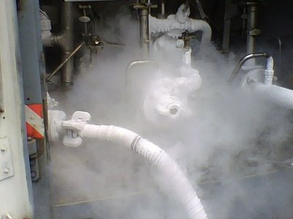
Health Hazard- Extreme Cold Hazard
Prolonged breathing may damage the lungs.
Brief exposures can damage the eyes.
Prolonged exposure of the skin can cause frostbite.
There is no initial pain but there is intense pain when frozen tissue thaws.
Unprotected skin can stick to metal. The skin can then tear when pulled away.

Slide 11
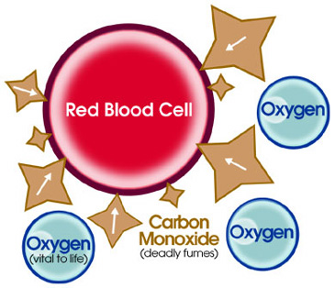
Health Hazard- Toxic Hazards
Some gases like carbon monoxide, fluorine, and nitrous oxide are toxic
Liquid carbon monoxide can generate large quantities of carbon monoxide gas, which can cause death almost immediately.

Slide 12
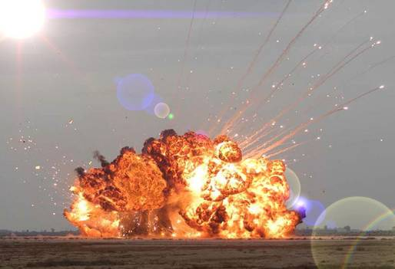
Explosion hazard
The liquid to gas expansion ratio N2 substance is 1:696.5, a tremendous amount of force can be generated if liquid nitrogen is rapidly vaporized.
The pressure inside causes an explosion popularly called as BLEVE or Boiling Liquid Expanding Vapor Explosion.
Containers should have adequate venting or pressure-relief devices and a backup bursting disc.

Slide 13
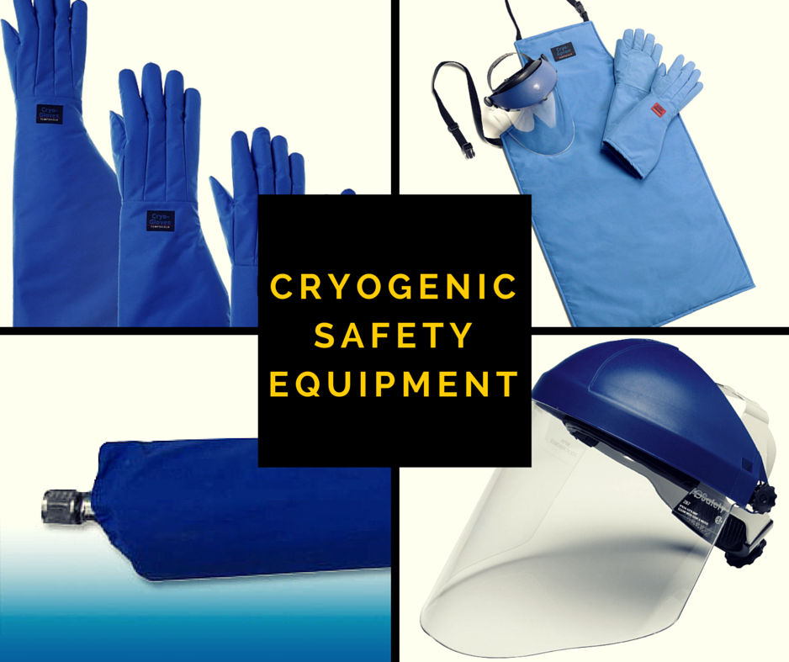
Personal Protective Equipment (PPE)
If you work with cryogenic liquids coming in contact with the skin is reduced with the use of PPE:
Full Face Shield with safety glasses
Heavy, Loose Fitting leather or Cryogenic Gloves
Long Sleeve Shirt/apron, or Arm Protection
High tight fitting safety shoe

Slide 14
First Aid Procedures
Skin contact may cause frostbite and burns. Seek medical assistance immediately when cryogens contact your skin. Lack of prompt medical attention may result in amputation!
Immediately upon exposure, the frozen skin appears waxy and yellow and the burn usually is not painful
Do not rub or massage the affected parts of the body.
It painfully swells and blisters while the skin defrosts
Immerse the affected area in a warm water bath not to exceed 40 °C or exposure to warm air.
Immediately follow these first-aid procedures until you get medical assistance
Take the victim away from the cryogen hazard.
Any clothing that may interfere with the circulation of blood to the frozen tissues should be removed in a slow, careful manner to prevent salvageable skin from being pulled off.
If the liquid is splashed in the eyes, flush with water for at least 15 minutes. Seek immediate medical attention.

Slide 15
Safety concerning use of Dewar
Use only containers designed for low-temperature liquids
Use care when filling portable dewar and do not overfill them.
Use only the loose-fitting neck tube core supplied or one of the approved accessories for closing the neck tube.
Do not ever cover or plug the entrance opening of any liquid nitrogen dewar.
Do not use any stopper or other device that would interfere with the venting of gas.
Inspect the containers for loss of insulating vacuum. If the outside of the jacket on a container is cold or has frost spots, some vacuum has been lost. Remove the damaged unit from service.
Excessive ice build-up (especially beneath the vaporizer or tank) could result in the discharge of excessively cold gas, or structural damage to the cryogenic container and surroundings.
Do not tamper with pressure relief valves or the settings for the valves.
Never use hollow rods or tubes as dipsticks; Wooden or solid metal dipsticks are recommended
Avoid using plastics that may become very brittle at cryogenic temperatures
Ensure dewars are properly labeled with the identity of the cryogen
Remove metal jewelry/watches on your hands and wrists before working with cryogens. If exposed to cryogenic liquids or boil-off gases, the jewelry can freeze to the skin
Wear a cryogen apron & gloves when working with cryogen liquids

Slide 16
Case Study (University of Rhode Island)
URI Researcher Loses Forearm in Laboratory Gas Explosion
A University of Rhode Island research assistant lost his right arm below the elbow when expanding gas exploded. John King 36, a URI professor who was in the same laboratory at the time, was blown through a lab door by the blast but was not seriously hurt.
Police said Burdett's arm was severed by a piece of flying metal. The blast occurred as Burdett was pouring nitrogen, a colorless gas that becomes a liquid when cooled to minus 196 degrees Celsius, from a large vessel into a smaller one. The pressure apparently climbed too high.
The laboratory contains a mass spectrometer that uses liquid nitrogen cool objects before they are examined.

